Slide 1
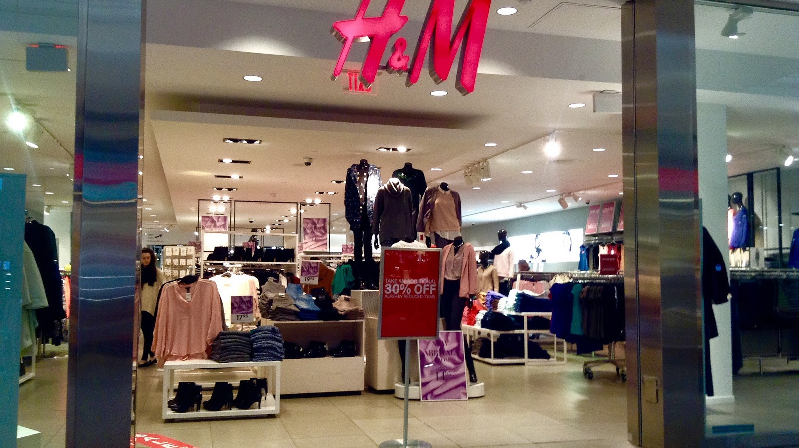
H & M MARKETING ANALYSIS
AN ANALYTICAL APPROACH USING 4 P’S FRAMEWORK

Slide 2

INTRODUCTION
The project aims to:
1.Understand sales pattern
2. Segment customers
3. Evaluate promotional effectiveness
4. Support strategic decision making

Slide 3
DATASET OVERVIEW
The dataset contains 7,260 rows and 24 columns, providing comprehensive information about H&M products.
Key variables include : MRP, Discount, Sale Price and product details such as description, material, fit, and seasonality indicators.
For data cleaning, irrelevant column (product URL) was dropped and required column (date of import) was converted to date time format.
There are no duplicate values, but few columns had missing values, that were filled with mode as they were categorical.
For accurate analysis, from net quantity column the numerical values were extracted

Slide 4
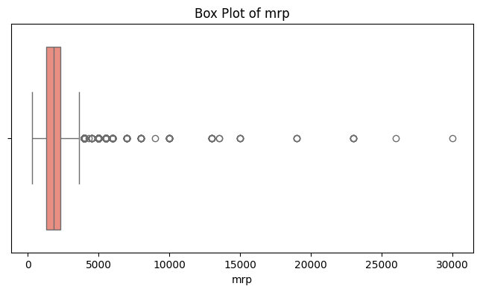
EXPLORATORY DATA ANALYSIS
1. Price Analysis
The median price is 1799 and
range of prices is within 299 to 29999.
The prices above 4999 are
considered as outliers as they
are priced higher than others.
The number of outliers are 659
in MRP.

Slide 5
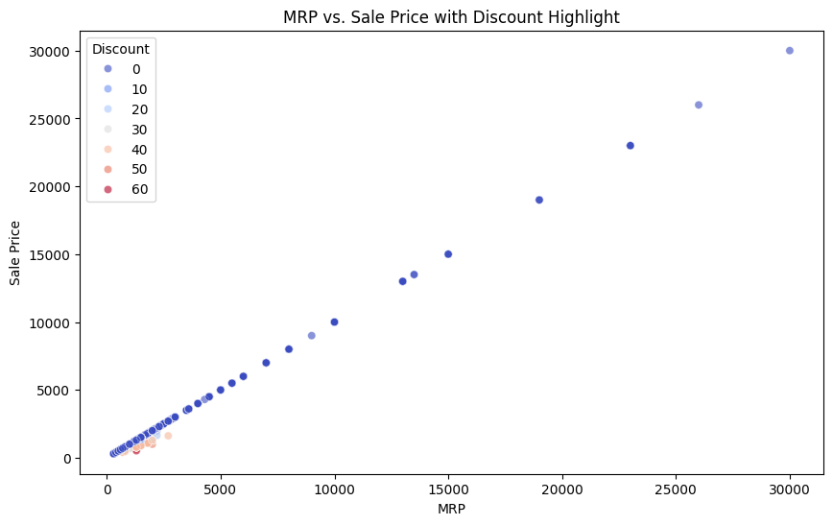
The points show a strong linear relationship between MRP and Sale Price, indicating that Sale Price is directly dependent on MRP.
Dark blue represents no discount (0%), while red represents the highest discount (60%).
Discounted products are below the diagonal, with lower Sale Prices than MRP.
At higher MRP values (e.g., above 20,000), discounts are less common, as shown by a lack of red/orange points in this range.

Slide 6
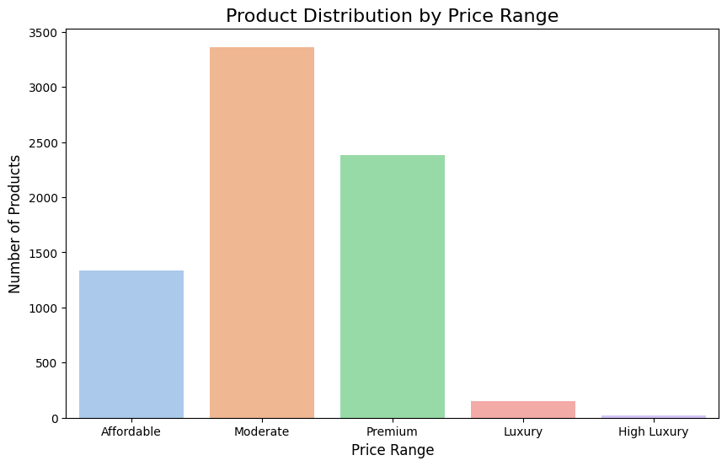
Affordable Range: 1337 products (18.4%) fall into this range.
Moderate Range: 3363 products (46.3%) fall into this range.
Premium Range: 2386 products (32.9%) fall into this range.
Luxury Range: 152 products (2.1%) fall into this range.
High Luxury Range: 22 products (0.3%) fall into this range

Slide 7
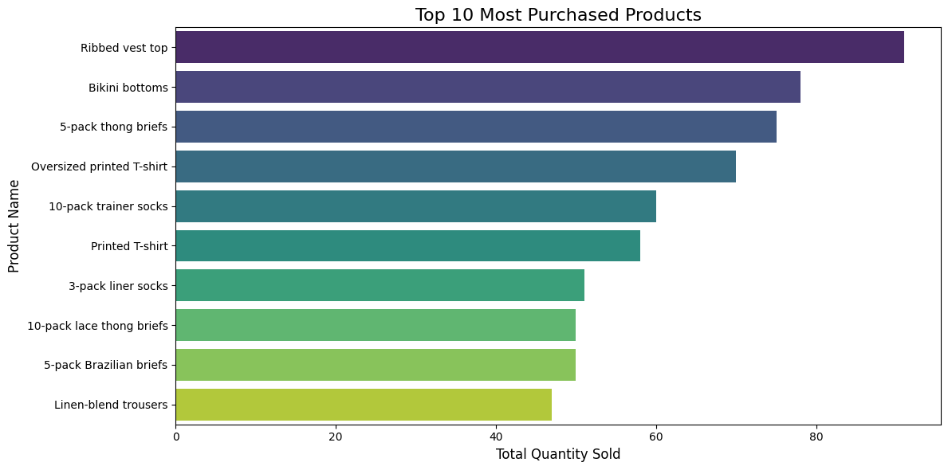
2. Product Analysis
The ribbed vest top is the most purchased product.
The essential items like trainer socks and liner socks are also frequently purchased, reflecting demand for basics.
Multipack products are also commonly purchased, indicating customer preference for value deals.

Slide 8
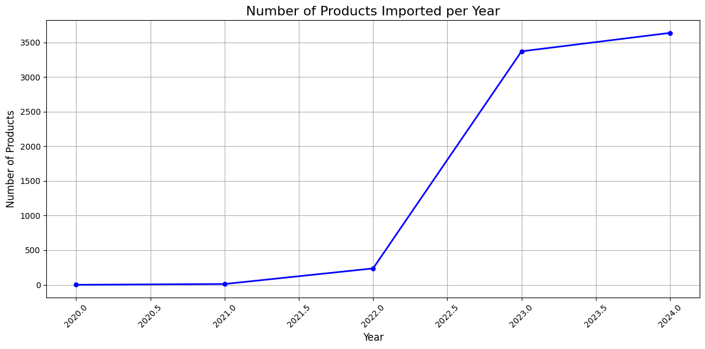
From 2020 to 2021, there is minimal activity in product imports, with very few products being recorded.
In 2022, a slight increase is observed, but the growth is still modest.
A significant surge occurs from 2022 to 2023, with the number of imported products increasing sharply.
The trend continues with a slight rise from 2023 to 2024, showing sustained high import volumes.

Slide 9
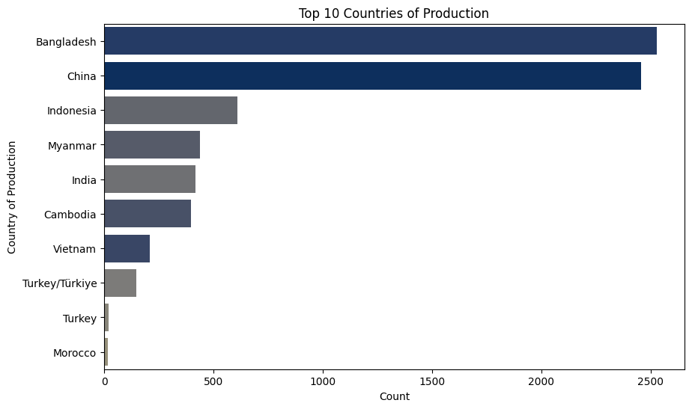
3. Place Analysis
Top 10 countries of production
Bangladesh and China,
lead significantly, with counts
exceeding 2000. They dominate the
Production compared to the
other countries.

Slide 10
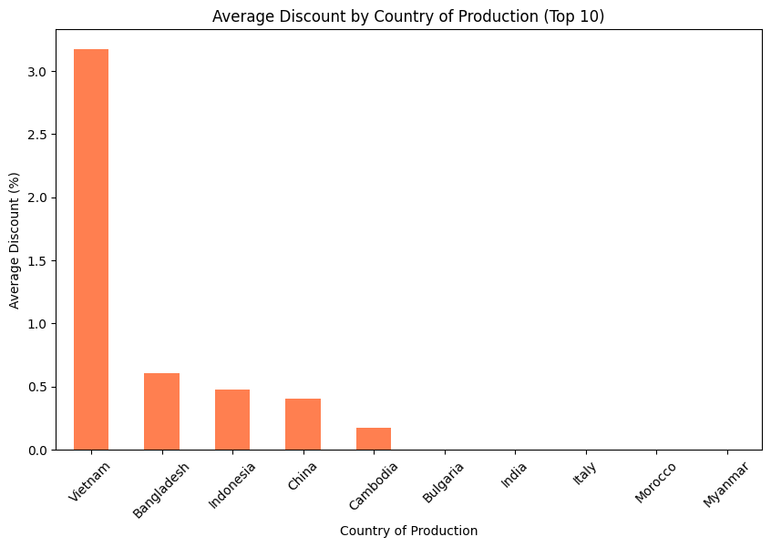
Vietnam stands out with the highest average discount, exceeding 3%.
Bangladesh, Indonesia, and China follow with average discounts between 0.5% and 1%

Slide 11
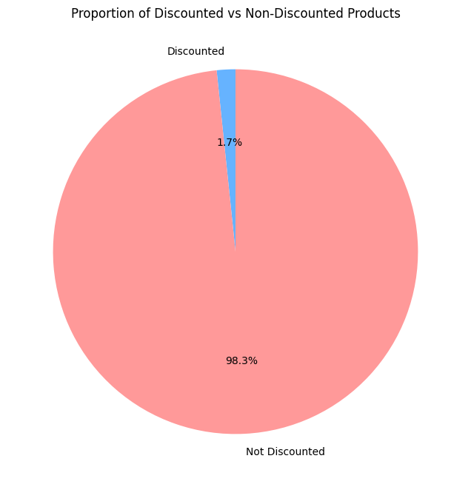
4. Promotion Analysis
The number of products with
discount in dataset is 120 and
number of product without discount
are 7140.
So, the proportion of products with
discount are 1.7% and without
discount is 98.3%.

Slide 12
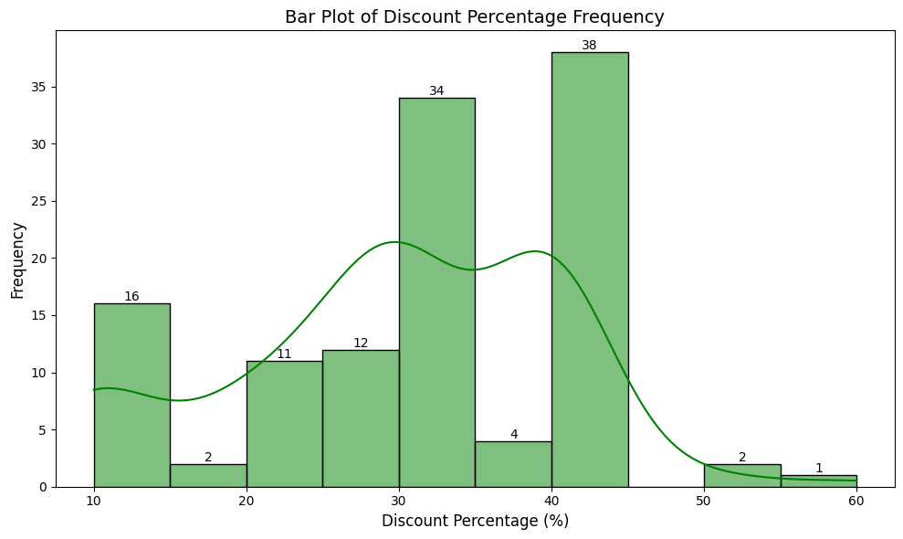
The highest frequency occurs in the 30-40% discount range, with 38 occurrences, indicating that this is the most common discount percentage offered.
The next frequent range is 20-30% discounts, with 34 occurrences.

Slide 13
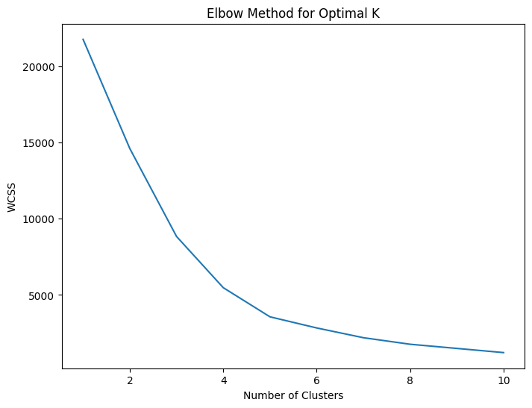
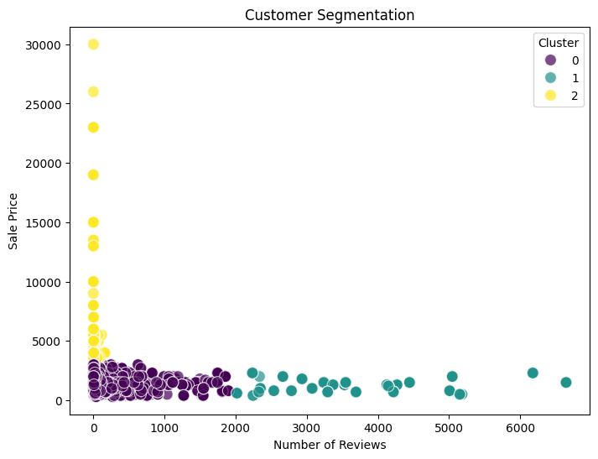
CUSTOMER SEGMENTATION

Slide 14

EXPLANATION:
The elbow method helps determine the optimal number of clusters (K) for a clustering algorithm such as K-means.
At a certain point, the rate of decline diminishes significantly, suggesting the optimal K.
The scatter plot visualizes the results of clustering customers into different segments.
Clusters: The points are color-coded into three clusters (0, 1, and 2), as determined by the K-means algorithm

Slide 15
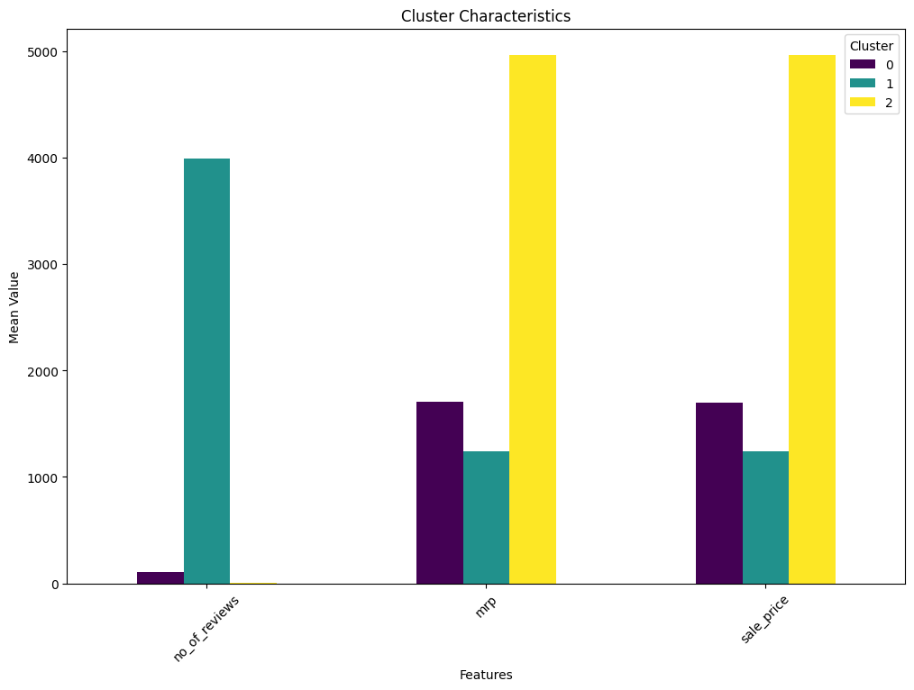
Cluster 0 (Purple):
Represents customers with
lower reviews, modest MRP,
and sale price.
Cluster 1 (Teal): Characterized by
the highest engagement (reviews) but
moderate MRP and sale price.
Cluster 2 (Yellow): Represents
high-value customers who purchase
expensive products at premium prices
but provide fewer reviews.

Slide 16
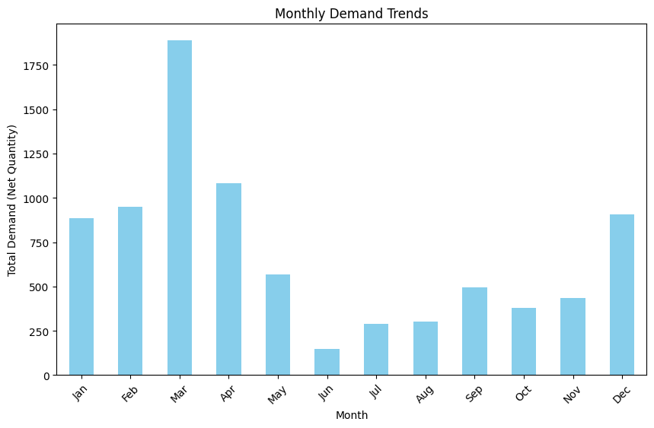
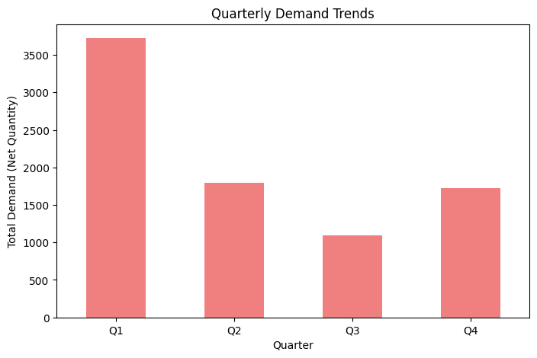
SEASONAL ANALYSIS
For all the quarters, Q1 has highest demand compared to others.
Whereas, in the month of March, the demand has been highest. As well as the winter season shows highest demand trend

Slide 17
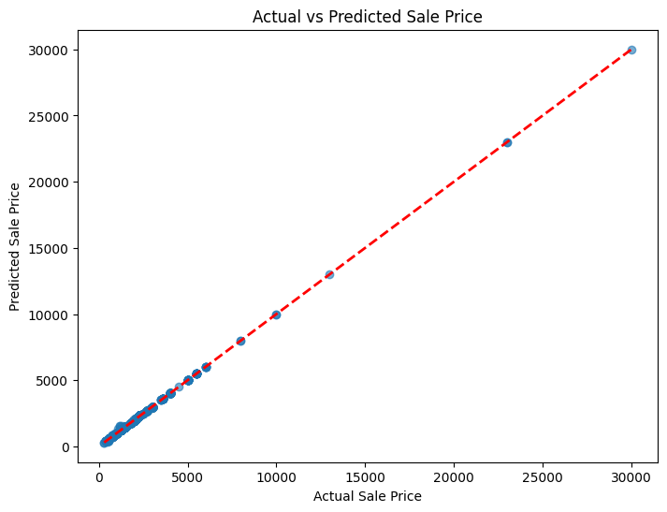
PREDICTIVE ANALYSIS
The scatterplot shows a upward trend. As the actual sale price increase, the predicted sale price also tends to increase.
The blue dots represent Actual sale prices.

Slide 18

RECOMMENDATIONS
Enhance Promotions on High-Demand Products
Offer dynamic discounts based on product category, seasonality, and demand trends.
Use social media and email campaigns to promote discounts and new arrivals.
Create subscription or loyalty programs offering exclusive discounts, early access to sales, and curated bundles.

Slide 19
CONCLUSION
Analysis revealed trends in product demand, pricing influence, and seasonal patterns, providing a clear direction for strategy refinement.
Focus on product optimization, targeted promotions, strategic pricing, and enhanced customer engagement for sustainable growth.
Leveraging these insights will enable H&M to adapt to market dynamics, improve customer satisfaction, and maintain a competitive edge.

Slide 20


